Slide 1
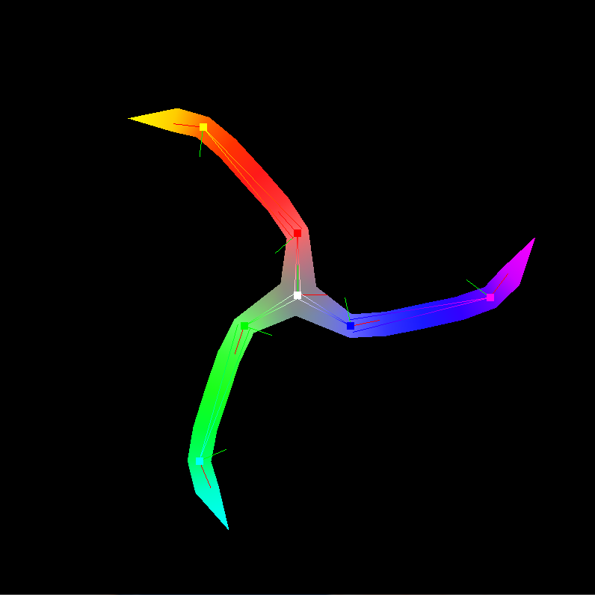
Skeletal Mesh Skinning
Using Vertex Shaders

Slide 2
What is a Skeletal Mesh?
Mesh + Skeleton
Don’t need to animate every vertex
Animate skeleton, and attach mesh to skeleton
Less data sent to GPU per frame => faster rendering

Slide 3
Keyframe vs Skeletal Animation
Keyframe Animation
Skeletal Animation
Simpler
More flexible poses
Slower rendering
Slower iteration
N meshes, N animation sets
Hard to interface with dynamic elements
More complex
Less pose flexibility
Faster rendering
Faster iteration
N meshes, 1 skeleton
Can interact with dynamic game elements (IK, etc)

Slide 4
Skinning
The act of “hanging” a mesh on a skeleton
Each vertex’s position determined by 1 or more “bones” or “joints”
Model is created in “bind pose”
Bind pose and current pose determine final vertex positions.

Slide 5
Joints
Often inaccurately called bones
Really just a hierarchical coordinate system.
A joint’s children are affected by changes to the joint’s coordinate system
Each vertex can be affected by more than one joint
The final position is the weighted average of the positions each joint thinks the vertex should be at.

Slide 6
Poses
The rotations, translations, and scales of all joints in a skeleton at a particular moment
Can be interpolated

Slide 7
Algorithm
Find a transformation matrix for each joint to convert a bind-pose vertex position in model space into a position relative to the joint.
Find a transformation matrix for each joint to convert a vertex position relative to the joint into a position in model space for the current pose.

Slide 8
Algorithm (cont’d)
For each vertex:
For each joint that affects the vertex:
Transform vertex from model-space to joint-space by multiplying it by the bind-pose transform above.
Transform vertex from joint-space back to model space, but this time in a different pose by using the second transform above.
Take the weighted average of the positions each joint thinks the vertex should be in.

Slide 9
Vertex Shader
#version 330
uniform mat4 bind_pose_inv[7];
uniform mat4 current_pose[7];
uniform vec4 current_pose_colors[7];
layout(location = 0) in vec2 position;
layout(location = 1) in uint joint_0_index;
layout(location = 2) in uint joint_1_index;
layout(location = 3) in uint joint_2_index;
layout(location = 4) in float joint_0_weight;
layout(location = 5) in float joint_1_weight;
layout(location = 6) in float joint_2_weight;
out vec4 color;

Slide 10
Vertex Shader (Cont’d)
void main()
{
vec4 vertex_coords = vec4(position, 0, 1);
gl_Position = vec4(0,0,0,0);
color = vec4(0,0,0,0);
// First joint affecting vertex
color += joint_0_weight * current_pose_colors[joint_0_index];
gl_Position += joint_0_weight * (current_pose[joint_0_index] *
bind_pose_inv[joint_0_index] *
vertex_coords);
// ... Repeat for other joints affecting vertex.
}

